Slide 1
Node js
Create your own server

Slide 2

What is node
Node.js is a popular open-source, cross-platform JavaScript runtime environment that executes JavaScript code outside of a web browser. Let's dive into some of its key aspects:

Slide 3

What is Web server
A web server is a software application or hardware device that stores, processes, and serves web pages to users over the Internet. It plays a crucial role in the delivery of content for websites, and understanding its functions can help you recognize why it's necessary for most online activities. Here's a breakdown of what a web server is and why you might need one:

Slide 4
Why Do You Need a Web Server?
Hosting a Website: If you want to make a website available to others on the Internet, you'll need a web server to host the site's files and handle incoming requests.
Creating a Web Application: For more complex sites with dynamic content, a web server can interpret programming languages like PHP, Ruby, or Python, allowing for interactive features and data-driven content.
Managing Traffic: Web servers are designed to manage multiple connections simultaneously, ensuring that many users can access a site at the same time without significant slowdowns.
Security and Access Control: Web servers can be configured to provide security measures, such as SSL/TLS for encrypted connections, and access controls to restrict who can view certain parts of a website.
Content Delivery and Optimization: Web servers can be optimized to deliver content efficiently, with features like compression, caching, and load balancing to ensure quick page loading and responsiveness.
Integration with Databases: In many modern web applications, web servers interact with databases to store and retrieve information, allowing for personalized and dynamic content.
Business and E-Commerce Applications: For businesses that conduct transactions online or provide customer portals, web servers are essential for managing these complex, interactive platforms.

Slide 5
What we are going to do
Node.js
Prisma

Slide 6

Node.js Overview steps
Create a Project Directory
Initialize a New Node.js Project
Install Express.js
Create a Server File
Write the Server Code
Run the Server
Access Your Server

Slide 7
Create a Project Directory
mkdir my-node-server-ts
cd my-node-server-ts

Slide 8

Initialize a New Node.js Project
npm init -y
https://blog.logrocket.com/how-to-set-up-node-typescript-express/

Slide 9
Install TypeScript, Express, and TypeScript Node
Install TypeScript, Express.js (a popular web framework), and ts-node (a TypeScript execution environment for Node) using the following command:
npm install typescript express ts-node
Install Type Definitions
npm install --save-dev @types/node @types/express
npm install dotenv
npx tsc --init
npm install -D concurrently nodemon

Slide 10
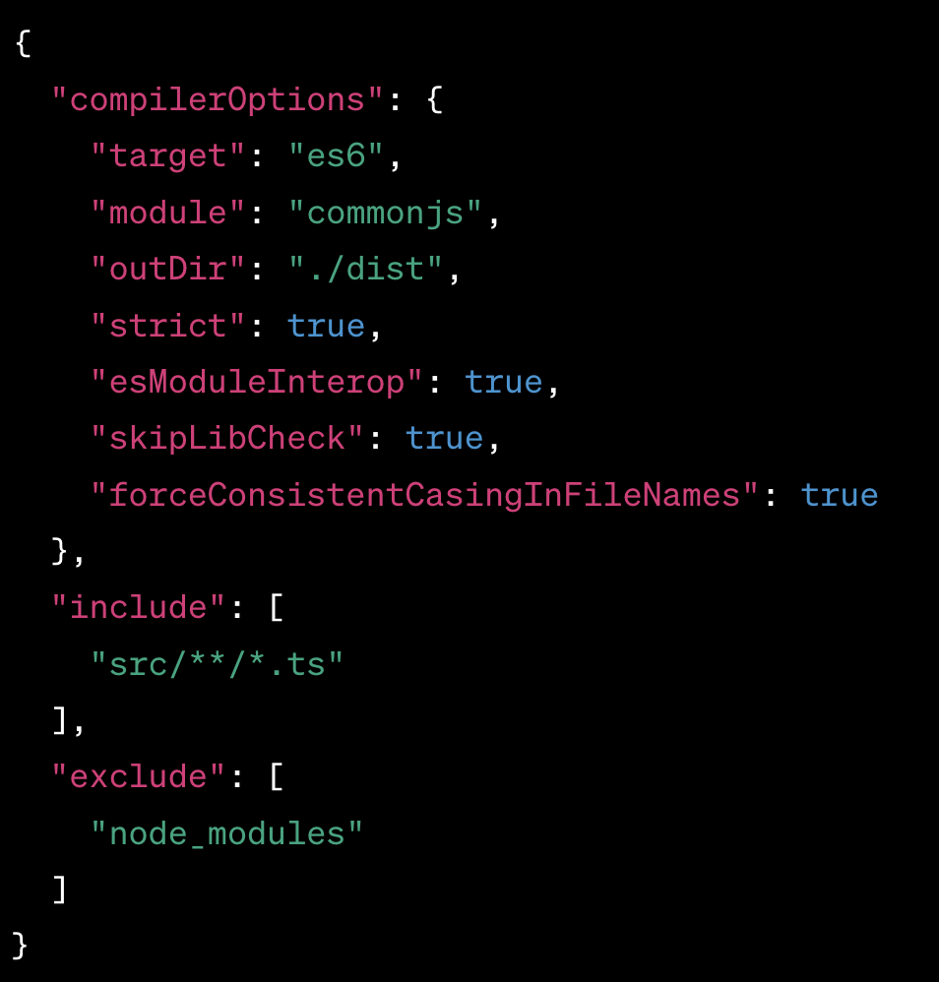
Create a TypeScript Configuration File
Create a tsconfig.json file to configure TypeScript compilation options:
npx tsc --init

Slide 11
Create a Source Directory
Create a Server File (server.ts)

Slide 12
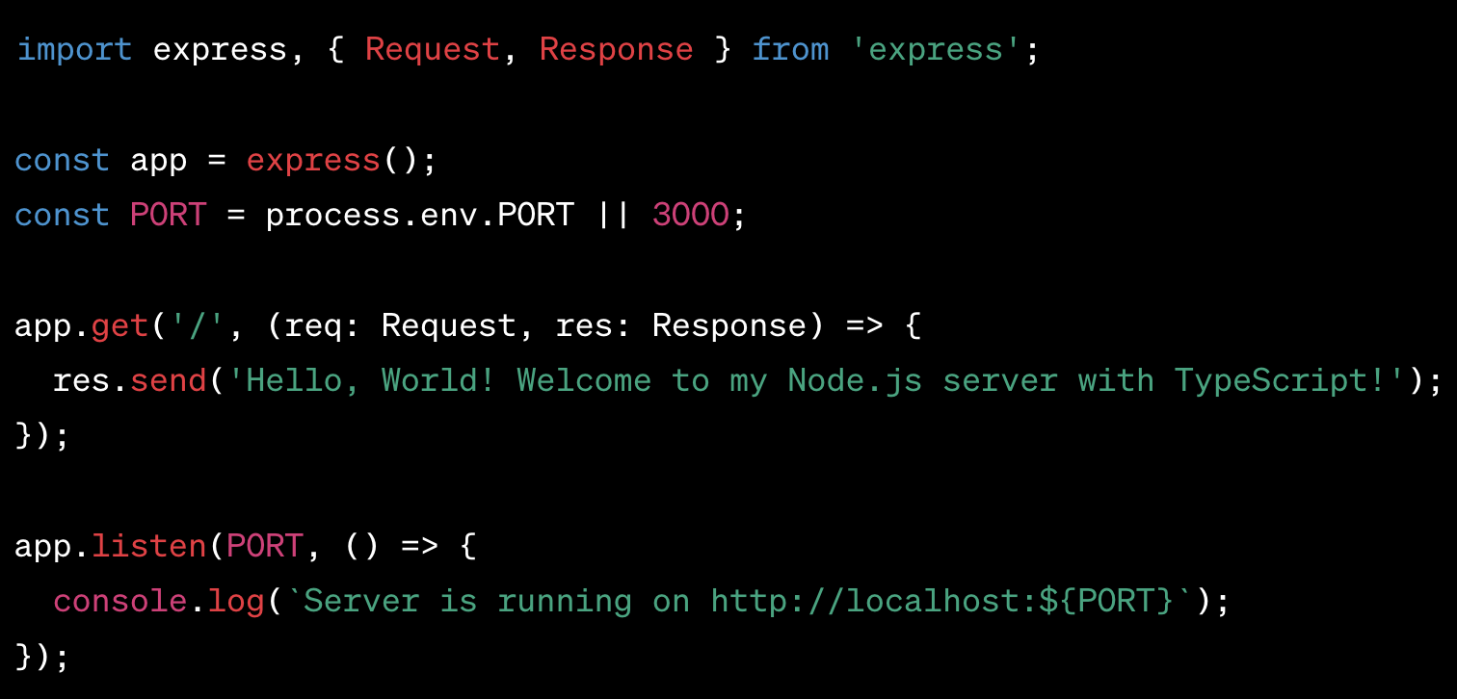
Write the Server Code

Slide 13
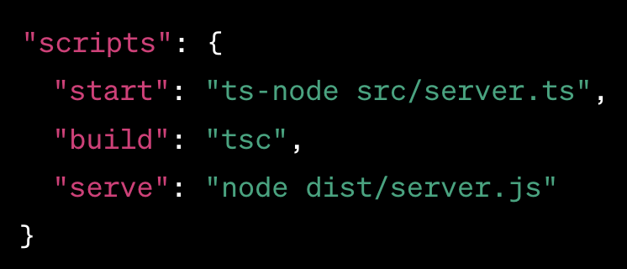
Add Start Scripts

Slide 14
Run the server
Npm run start

Slide 15

Node get query parameters
getData example

Slide 16
validators
npm i express-validator
npm i zod

Slide 17
cors
npm install cors
sudo npm i --save-dev @types/cors

Slide 18
What is cors
CORS stands for Cross-Origin Resource Sharing.
It's a security feature implemented by web browsers to control requests made to another domain from web pages.

Slide 19
Why CORS Exists
The web operates on a security model called the "same-origin policy." This policy dictates that browsers should prevent web pages from making requests to a different domain than the one the web page came from, unless the target domain explicitly allows it. The reason behind this is to prevent malicious scripts on one page from accessing sensitive data on another web page through the browser.

Slide 20
How CORS Works
CORS works by adding specific HTTP headers that tell the browser that the content of a web application running at one origin has permission to access resources from a server at a different origin.

Slide 21
How does it work
Preflight Request: Before sending the actual request, the browser may send a preliminary "preflight" request (using the OPTIONS HTTP method) to check whether it has the permissions to perform the actual request. This happens for non-simple requests, i.e., requests that can't be made using just a form.
Actual Request: If the preflight is successful (or if the request is a simple one that doesn't require a preflight), the browser will send the actual request.
Server Response: The server includes CORS-specific headers in its response, such as Access-Control-Allow-Origin, to indicate which origins are allowed. The browser then checks these headers against the requesting web page's origin. If the origin is in the allowed list, the browser processes the response; otherwise, it denies it.

Slide 22
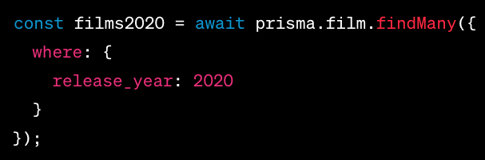
SELECT with WHERE

Slide 23
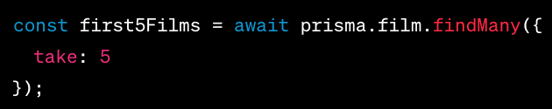
LIMIT

Slide 24
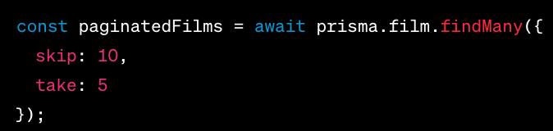
Pagination

Slide 25
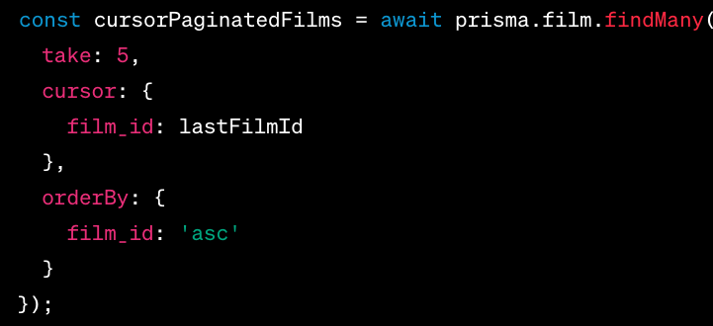
Cursor-Based Pagination

Slide 26
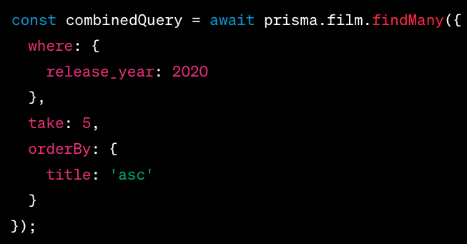
Combining Queries

Slide 27
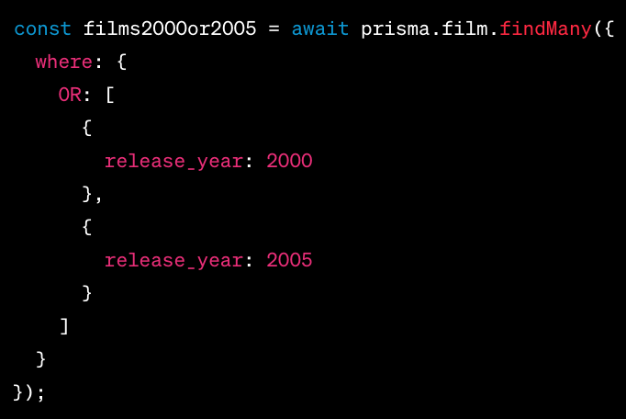
OR

Slide 29
trpc
npm install @trpc/server @trpc/client
tRPC (Tiny Remote Procedure Call) is a library that seeks to give developers the benefits of GraphQL without the overhead of defining a GraphQL schema. It leverages TypeScript's advanced type inference to automatically generate APIs from your code, making it ideal for TypeScript users.

Slide 30
Point 1
Type-Safety: One of the standout features of tRPC is its end-to-end type-safety. With TypeScript, you define procedures (essentially functions), and tRPC ensures that both the input to and output from these procedures are type-checked. This reduces the chances of runtime errors related to unexpected data shapes.

Slide 31
Point 2
No More Over-fetching or Under-fetching: Like GraphQL, tRPC lets you request exactly what you need, eliminating the problems of over-fetching or under-fetching data.

Slide 32
Point 3
No Schema or ORM Required: Unlike GraphQL which requires a schema, or REST which often works best with an ORM for complex applications, tRPC doesn't mandate either. Your procedures simply call your database (or any other data source) directly.

Slide 33
Point 4
Procedure-Based Instead of Resource-Based: Unlike REST, which is resource-based (think /users, /posts, etc.), tRPC is procedure-based. You define procedures (functions) that your client can call, passing in any necessary arguments.

Slide 34
more
Backend and Frontend Integration: There are tRPC client libraries tailored for React and other popular front-end frameworks. These libraries make it straightforward to call backend procedures from the frontend, and they integrate with popular data-fetching libraries.
Simple Query Invalidations: With tRPC client libraries, it's easy to invalidate or refetch queries, making state management simpler, especially in SPAs (Single Page Applications).
Express and Next.js Adapters: While tRPC was initially designed with Next.js in mind, it does offer adapters for other frameworks, including Express.
Extensible: It's designed with extensibility in mind, so you can add custom middlewares, error handling, and more.
Validation: Procedures in tRPC can validate their input using popular libraries like zod or yup.

Slide 35
Get started - react
npm install @trpc/client @trpc/server @trpc/react-query @tanstack/react-query
https://trpc.io/docs/client/react/setup

Slide 43
What is V8 JavaScript Engine
Node.js uses Google's V8 JavaScript engine to execute code. V8 is the same engine used in Google Chrome and other Chromium-based browsers, and it compiles JavaScript directly to native machine code for fast execution.

